Slide 1
The perception and production of two vowel mergers
in Cowlitz County, Washington
Joey Stanley
University of Georgia
joeystan@uga.edu @joey_stan
joeystanley.com
American Dialect Society Annual Meeting
Austin, Texas
January 5, 2017

Slide 2
Cowlitz County, Washington
O
O
O
0
0
O
0
Notes:
Mt. St. Helens: 36 miles as the crow flies
Sparse before 1923
Population tripled with Longview
Loggers, mill workers

Slide 3
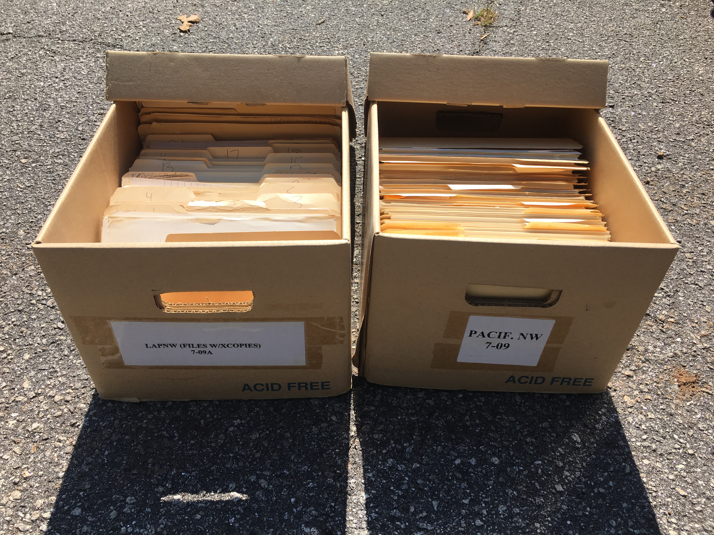
Pacific Northwest English (cf. Stanley 2016)
prevelar /e, ɛ, æ/ raising and merging (Wassink et al. 2009, Freeman 2014, Riebold 2015, etc.)
= Mary-merry-marry vowels
/u, ʊ, o/ fronting (Ward 2003, Becker et al. 2013, McLarty & Kendall 2014, etc.)
= pool-pull-pole(-pulp) vowels
Linguistic Atlas of the Pacific Northwest (LAPNW) (Reed 1952, 1956, 1957, 1961)

Slide 4
Mary-merry-marry Merger
M/e/ry = m/ɛ/rry = m/æ/rry (henceforth “pre-rhotics”)
ANAE: “This query was not pursued in most areas of the West and Midwest.”
(Labov, Ash, & Boberg 2006:54, note 6)
Change in progress 60 years ago
fully merged (Reed 1952, Thomas 1958, Foster & Hoffman 1966)
yet…
a few older speakers retain /e/ in Mary and /æ/ in marry (Reed 1961:560)
chair ”sporadically” as [ɛ^{ɪ}] in eastern Washington (561)
near even distribution of [ɛ] and [æ] in parents (562)

Slide 5
“Pre-Lateral” Mergers
several mergers involving back vowels before coda laterals
pool-pull
hull-hole
“deserve further study” (Labov, Ash, & Boberg 2006: 73)
variable in Maryland (Bowie 2001), Ohio (Arnold 2014), Missouri (Strelluf 2016), and Utah (Baker & Bowie 2010)
bulk and bulge as [ʌ] or [ʊ], pull as [ʊ] (Reed 1961)
ghoul
pool
who’ll
ul
pull-pole
pull-hull
pull
fool
ʊl
dual
full
bull
goal
pole
hole
ol
gull
(pulp)
hull
foal
bowl
ʌl
dole
dull
Notes:
Me and Mike. Me and my brothers.

Slide 6
Overview
mary-merry-marry historically variable, but likely merged today
Status of pre-lateral mergers is unknown, though impressionistically less clear cut
Hypothesis 1: complete mary-merry-marry merger
Hypothesis 2: separation of pool, pull, pole, and pulp
Hypothesis 3: production/intuition mismatch

Slide 7
Methodology

Slide 8
Data Collection
40 natives of Cowlitz County, ages 18–70s
word list (23) and minimal pairs (14)
list in appendix slides
intuition of own minimal pairs
forced aligned with DARLA (Reddy & Stanford 2015), which uses ProsodyLab (Gorman, Howell, & Wagner, 2011) and FAVE (Rosenfelder, Fruehwald, Evanini, & Yuan 2011)
hand-corrected boundaries and extracted formants myself
Number of tokens
 | word list | minimal pairs | total
pre-laterals | 376 | 842 | 1,218
pre-rhotics | 342 | 509 | 851
total | 718 | 1,351 | 2,069
Notes:
Minimal pairs were embedded in some pairs that should have been cateogorically merged and some that should have been different.

Slide 9
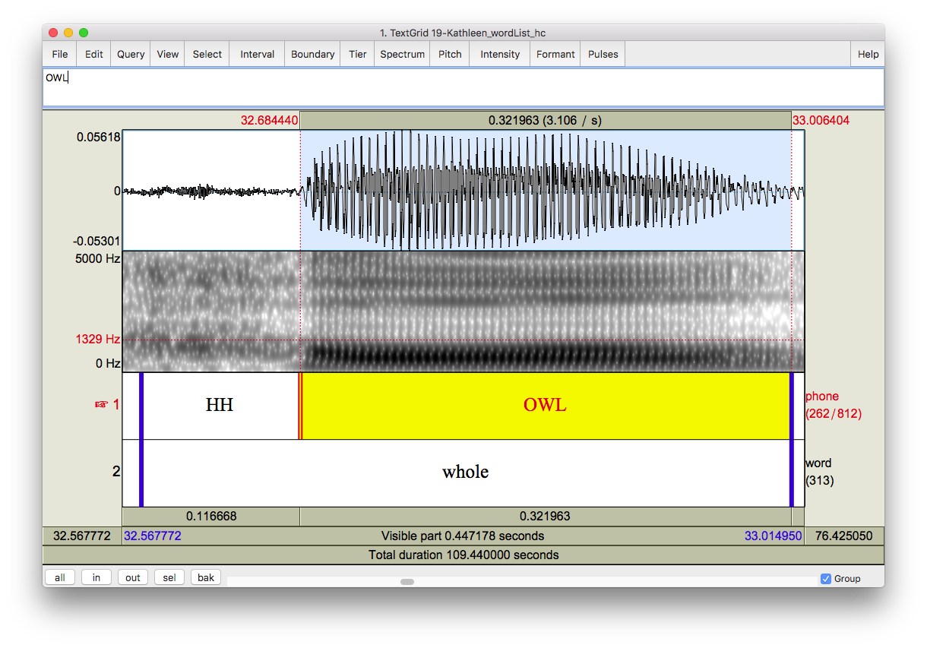
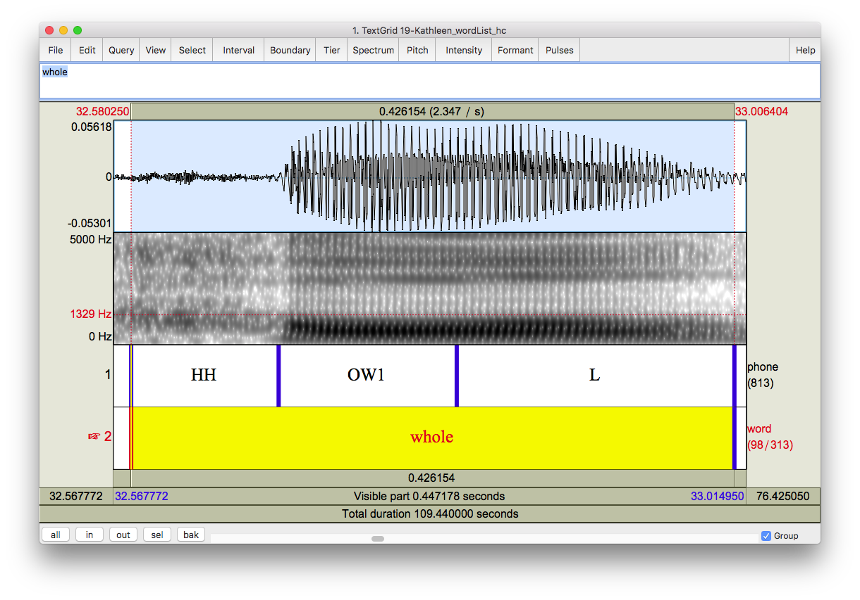
Formant Extraction
boundaries can be arbitrary
formants extracted at 15 points along the vowel+liquid duration
25% point used for now
(reasoning in appendix slides)
Bark normalized (Traunmüller 1997)
Lobanov not ideal since not all vowels are present (Thomas & Kendall 2007–2015)
?
?
?

Slide 10
Results

Slide 11
Pre-Laterals: Minimal Pairs
pool is higher
pulp is lower and fronter
(statistics in appendix slides)
pull = pole
(independent two-sided t-tests)
F1: t_{(215.15)} = 0.13, p = 0.89
F2: t_{(253.56)} = 2.50, p = 0.01
Pillai score: 0.02 (cf. Hay, Warren, & Drager 2006, Hall-Lew 2010, Nycz & Hall-Lew 2013)
Bhattacharyya’s affinity: 0.97
(cf. Bhattacharyya 1943, Calenge 2006, Johnson 2015)

Slide 12
Pre-Laterals: Word List
pull = pole
(independent two-sided t-tests)
F1: t_{(191.45)} = 2.06, p = 0.04
F2: t_{(212.96)} = 3.88, p < 0.001
Pillai score: 0.07
Bhattacharyya’s affinity: 0.95
Notes:
Pillai: 0 = complete overlap, 1 = complete separation;
Bhat: 1 = complete overlap, 0 = complete separation

Slide 13
Pre-Laterals: Perception
% = pairs reported merged
hesitant responses
ghoul
pool
who’ll
ul
pull
17%
fool
ʊl
duel
full
bull
23%
goal
pole
hole
ol
gull
(pulp)
hull
14%
foal
bowl
ʌl
dole
dull
Notes:
Lots of doubt, “close”, and unsure reponses

Slide 14
Pre-Rhotics: Word List
merry = marry—no doubt about it
mary slightly higher than m{e,a}rry
(independent one-sided t-tests)
F1: t_{(175.87)} = –6.44, p < 0.001
F2: t_{(188.15)} = 4.36, p < 0.001
Pillai score: 0.20
Bhattacharyya’s affinity: 0.90
Notes:
No t.tests because data is bimodal (probably because of the bad measurements)

Slide 15
Pre-Rhotics: Minimal Pairs
(near-)complete merger
hint of a three-way distinction
slight mary~marry distinction
(independent one-sided t-tests)
F1: t_{(212.07)} = –4.11, p < 0.001
F2: t_{(257.82)} = 2.67, p = 0.004
Pillai score: 0.13
Bhattacharyya’s affinity: 0.94
“phoneme continuum”?
(see appendix slides)

Slide 16
Pre-Rhotics: Perception
confidently answered
mary (/e/) = merry (/ɛ/): 98%
mary (/e/) = marry (/æ/): 99%
merry (/ɛ/) = marry (/æ/): 97%

Slide 17
Overview
 | pull vs. pole word list minimal pairs |  | mary vs. merry/marry word list minimal pairs
production | “merged” | merged | distinct | phoneme continuum
speaker intuition | 23% reported merged |  | 98% reported merged
clear case of “near-merger” (Labov et al. 1972, Labov et al. 1991, Di Paolo 1992, Bowie 2001, etc.)
mary-merry/marry: distinct in production, merged in perception
pull-pole: merged in production, distinct in perception

Slide 18
Conclusion
Cowlitz County natives merge pull and pole while maintaining a distinction between mary and merry/marry.
Hypothesis 1: ✗ complete mary-merry-marry merger
Hypothesis 2: ✗ separation of pool, pull, pole, and pulp
Hypothesis 3: ✓ production/intuition mismatch
awareness of possible distinction affecting intuition?
Ongoing changes in Cowlitz County
Notes:
Do the trajectory plot, split by age and gender
This is interesting because it's a conditioned merger that is ongoing and I'm trying to track it.

Slide 19
References
Arnold, Lacey R. 2014. Production and perception of the pre-lateral, non-low, back vowel merger in northeast Ohio. The Journal of the Acoustical Society of America 135(4). 2425–2425.
Becker, Kara, Anna Aden, Katelyn Best, Rena Dimes, Juan Flores & Haley Jacobson. 2013. Keep Portland weird: Vowels in Oregon English. Paper presented at the New Ways of Analyzing Variation (NWAV) 42, Pittsburgh.
Baker, Wendy & David Bowie. 2010. Religious affiliation as a correlate of linguistic behavior. University of Pennsylvania Working Papers in Linguistics 15(2). 2.
Bhattachayya, A. 1943. On a measure of divergence between two statistical population defined by their population distributions. Bulletin Calcutta Mathematical Society 35. 99–109.
Bowie, David. 2001. Dialect Contact and Dialect Change: The Effect of Near-Mergers. University of Pennsylvania Working Papers in Linguistics 7(3). 3.
Calenge, Clément. 2006. The package “adehabitat” for the R software: A tool for the analysis of space and habitat use by animals. Ecological Modelling 197(3–4). 516–519. doi:10.1016/j.ecolmodel.2006.03.017.
Foster, David William & Robert J. Hoffman. 1966. Some observations on the vowels of Pacific Northwest English (Seattle area). American Speech. 119–122. doi:10.2307/453130.
Freeman, Valerie. 2014. Bag, beg, bagel: Prevelar raising and merger in Pacific Northwest English. University of Washington Working Papers in Linguistics 32.
Gorman, Kyle, Jonathan Howell & Michael Wagner. 2011. Prosodylab-Aligner: A Tool for Forced Alignment of Laboratory Speech. Canadian Acoustics 39(3). 192–193.
Hall-Lew, Lauren. 2010. Improved representation of variance in measures of vowel merger. Paper presented at the 159th Meeting Acoustical Society of America/NOISE-CON 2010, Baltimore, MD.
Hay, Jennifer, Paul Warren & Katie Drager. 2006. Factors influencing speech perception in the context of a merger-in-progress. Journal of Phonetics 34(4). (Modelling Sociophonetic Variation). 458–484. doi:10.1016/j.wocn.2005.10.001.
Johnson, Daniel Ezra. 2015. Quantifying vowel overlap with Bhattacharyya’s affinity. Paper presented at the New Ways of Analyzing Variation (NWAV44), Toronto.
Labov, William, Mark Karen & Corey Miller. 1991. Near-mergers and the suspension of phonemic contrast. Language Variation and Change 3(1). 33–74. doi:10.1017/S0954394500000442.
Labov, William, Malcah Yaeger & Richard Steiner. 1972. A quantitative study of sound change in progress. . Vol. 1. US Regional Survey.
Nycz, Jennifer & Lauren Hall-Lew. 2013. Best practices in measuring vowel merger. Proceedings of Meetings on Acoustics 20(1). 060008. doi:10.1121/1.4894063.
McLarty, Jason & Tyler Kendall. 2014. The relationship between the high and mid back vowels in Oregonian English. Paper presented at the New Ways of Analyzing Variation (NWAV) 43, Chicago.
Labov, William, Ingrid Rosenfelder & Josef Fruehwald. 2013. One hundred years of sound change in Philadelphia: Linear incrementation, reversal, and reanalysis. Language 89(1). 30–65.
Paolo, Marianna Di. 1992. Hypercorrection in response to the apparent merger of (ɔ) and (α) in Utah english. Language & Communication 12(3). 267–292. doi:10.1016/0271-5309(92)90017-4.
Reddy, Sravana & James N. Stanford. 2015. Toward completely automated vowel extraction: Introducing DARLA. Linguistics Vanguard 0(0). doi:10.1515/lingvan-2015-0002 (26 October, 2015).
Reed, Carroll E. 1952. The Pronunciation of English in the State of Washington. American Speech 27(3). 186–189. doi:10.2307/453476.
Reed, Carroll E. 1956. Washington Words. Publication of the American Dialect Society 25(1). 3–11. doi:10.1215/-25-1-3.
Reed, Carroll E. 1957. Word geography of the Pacific Northwest. Orbis 6. 86–93.
Reed, Carroll E. 1961. The Pronunciation of English in the Pacific Northwest. Language 37(4). 559–564. doi:10.2307/411357.
Riebold, John Matthew. 2015. The Social distribution of a regional change: /æg, ɛg, eg/ in Washington State. Seattle: University of Washington PhD dissertation.
Rosenfelder, Ingrid; Fruehwald, Joe; Evanini, Keelan and Jiahong Yuan. 2011. FAVE (Forced Alignment and Vowel Extraction) Program Suite. http://fave.ling.upenn.edu.
Strelluf, Christopher. 2016. Overlap among back vowels before /l/ in Kansas City. Language Variation and Change 28(3). 379–407. doi:10.1017/S0954394516000144.
Stanley, Joseph A. 2016. Pacific Northwest English: Historical Overview and Current Directions. The University of Georgia Working Papers in Linguistics 3.
Thomas, Charles Kenneth. 1958. An Introduction to the Phonetics of American English. 2nd ed. New York.
Thomas, Erik R. & Tyler Kendall (2007–2015). “NORM's Vowel Normalization Methods (v. 1.1)” Webpage. Accessed November 16, 2016. http://lingtools.uoregon.edu/norm/norm1_methods.php.
Traunmüller, Hartmut. 1997. Auditory scales of frequency representation. Stockholms universitet: Instituionen för lingvistik. http://www2.ling.su.se/staff/hartmut/bark.htm (17 November, 2016).
Wassink, Alicia Beckford, Robert Squizzero, Mike Scanlon, Rachel Schirra & Jeff Conn. 2009. Effects of Style and Gender on Fronting and Raising of /æ/, /e:/ and /ε/ before /ɡ/ in Seattle English. Paper presented at the New Ways of Analyzing Variation (NWAV) 38, Ottawa.
Ward, Michael. 2003. Portland dialect study: The fronting of/ow, u, uw/ in Portland, Oregon. Portland State University Master’s Thesis.

Slide 20
Joey Stanley
University of Georgia
joeystan@uga.edu @joey_stan
joeystanley.com
Special thanks to Cathy Jones for invaluable help in finding research participants,
to the University of Georgia Graduate School Dean’s Award for funding the fieldwork,
and to both the UGA Linguistics Program and the UGA Graduate School for travel funding.
This slideshow available at
joeystanley.com/ADS2017

Slide 21
Appendices

Slide 22
Word List Items
These were embedded psuedorandomly in a 160-item word list, with words targeting other research questions acting as fillers.
Participants often commented on how random the words seemed, so they likely did not catch on to the research questions these words targeted.
/er/ | dairy, hairy, vary
/ɛr/ | heritage, numeric, sheriff
/ær/ | arrow, carry, narrate, parrot, sparrow
/ul/ | cool, school
/ʊl/ | fulcrum, pulpit, wool
/ol/ | control, holster, stroll, whole
/ʌl/ | adult, culprit, vulture
The following words were excluded because they did not satisfy the required syllable type for their particular merger (open syllables for Mary-merry-marry and closed syllables for the pre-laterals), which was only learned after data-collection:
bullet, (Coca-)Cola, gullible, hooligan, polar (bear), pulley, sullen, tulips, yuletide,

Slide 23
Minimal Pairs & Triplets
/er/ | /ɛr/ | /ær/
fairy | ferry
 | perish | parish
 | very | vary
 | terrible
hairy |  | Harry
Mary | merry | marry
/ul/ | /ʊl/ | /ol/ | /ʌl/
rule |  | role
stool |  | stole
 | bull | bowl
 |  | goal | gull
 |  | colt | cult
 | whole/hole
 | bolder/boulder
school |  |  | skull
who’ll |  | hole | hull
pool | pull | pole
fool | full | pole
The pairs bear~bare, hair~hare, and stares~stairs were excluded because the targeted vowel was not before an intervocalic /r/.
The word terrible was paird with the invented word “tear-able” (as in ’able to be torn’), but participants didn’t respond well to that, and it was excluded.
Pairs from the same class are assumed to be homophonous for all speakers and were included to test speakers’ attention.

Slide 24
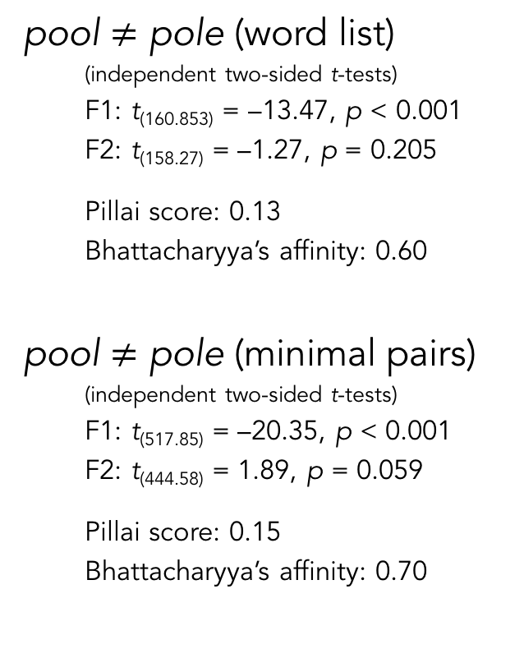
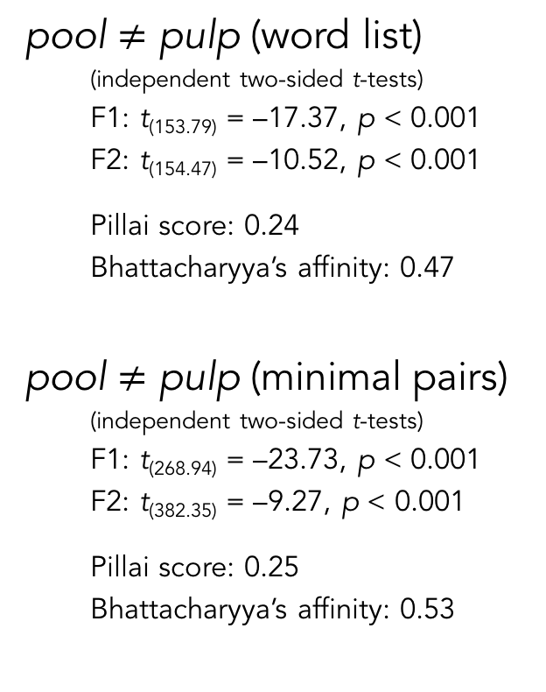
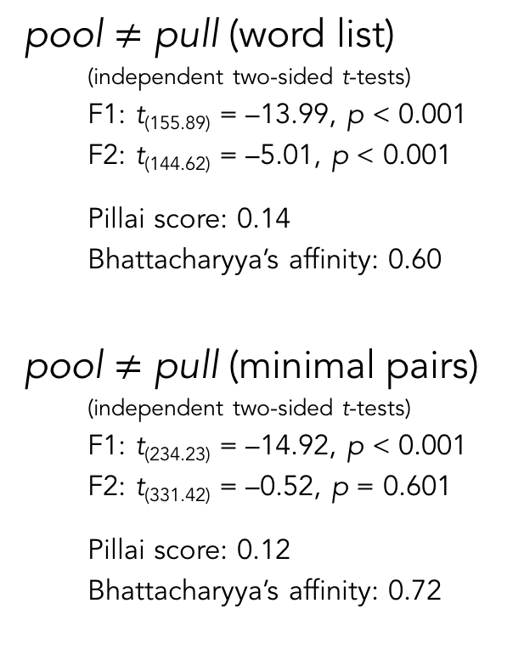
Pool Statistics
pool $≠$ pull (word list)
(independent two-sided t-tests)
F1: t_{(155.89)} = –13.99, p < 0.001
F2: t_{(144.62)} = –5.01, p < 0.001
Pillai score: 0.14
Bhattacharyya’s affinity: 0.60
pool $≠$ pull (minimal pairs)
(independent two-sided t-tests)
F1: t_{(234.23)} = –14.92, p < 0.001
F2: t_{(331.42)} = –0.52, p = 0.601
Pillai score: 0.12
Bhattacharyya’s affinity: 0.72
pool $≠$ pole (word list)
(independent two-sided t-tests)
F1: t_{(160.853)} = –13.47, p < 0.001
F2: t_{(158.27)} = –1.27, p = 0.205
Pillai score: 0.13
Bhattacharyya’s affinity: 0.60
pool $≠$ pole (minimal pairs)
(independent two-sided t-tests)
F1: t_{(517.85)} = –20.35, p < 0.001
F2: t_{(444.58)} = 1.89, p = 0.059
Pillai score: 0.15
Bhattacharyya’s affinity: 0.70
pool $≠$ pulp (word list)
(independent two-sided t-tests)
F1: t_{(153.79)} = –17.37, p < 0.001
F2: t_{(154.47)} = –10.52, p < 0.001
Pillai score: 0.24
Bhattacharyya’s affinity: 0.47
pool $≠$ pulp (minimal pairs)
(independent two-sided t-tests)
F1: t_{(268.94)} = –23.73, p < 0.001
F2: t_{(382.35)} = –9.27, p < 0.001
Pillai score: 0.25
Bhattacharyya’s affinity: 0.53
This is admitedly interesting. /ʊl/ is a bit fronter in the minimal pairs than in the word list.
To be expected: /ul/ is the same backness as /ol/

Slide 25
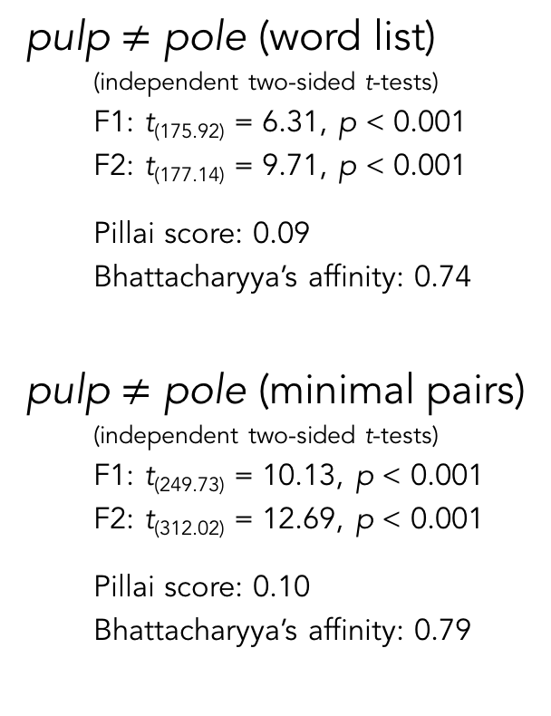
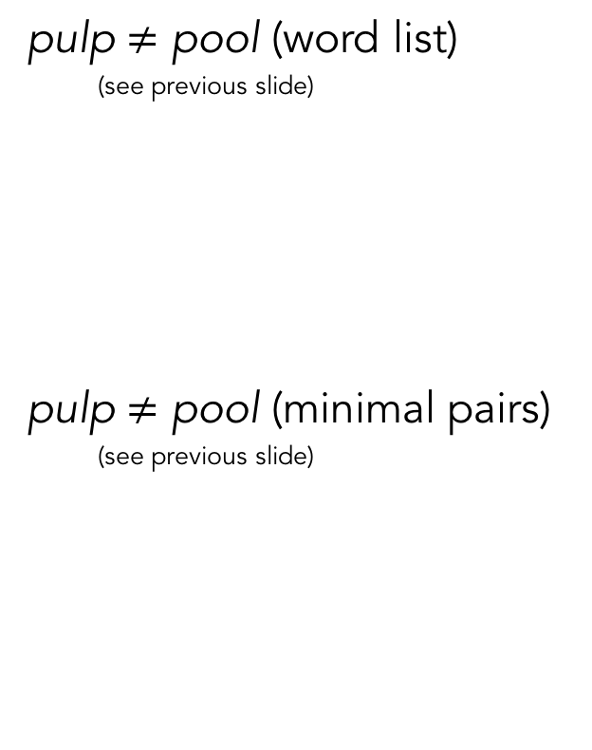
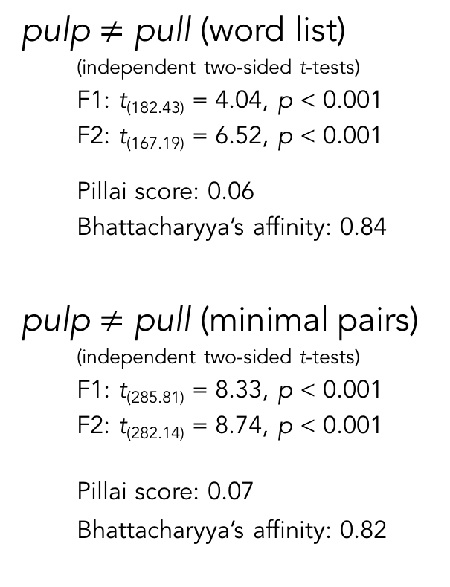
Pulp Statistics
pulp $≠$ pool (word list)
(see previous slide)
pulp $≠$ pool (minimal pairs)
(see previous slide)
pulp $≠$ pull (word list)
(independent two-sided t-tests)
F1: t_{(182.43)} = 4.04, p < 0.001
F2: t_{(167.19)} = 6.52, p < 0.001
Pillai score: 0.06
Bhattacharyya’s affinity: 0.84
pulp $≠$ pull (minimal pairs)
(independent two-sided t-tests)
F1: t_{(285.81)} = 8.33, p < 0.001
F2: t_{(282.14)} = 8.74, p < 0.001
Pillai score: 0.07
Bhattacharyya’s affinity: 0.82
pulp $≠$ pole (word list)
(independent two-sided t-tests)
F1: t_{(175.92)} = 6.31, p < 0.001
F2: t_{(177.14)} = 9.71, p < 0.001
Pillai score: 0.09
Bhattacharyya’s affinity: 0.74
pulp $≠$ pole (minimal pairs)
(independent two-sided t-tests)
F1: t_{(249.73)} = 10.13, p < 0.001
F2: t_{(312.02)} = 12.69, p < 0.001
Pillai score: 0.10
Bhattacharyya’s affinity: 0.79

Slide 26
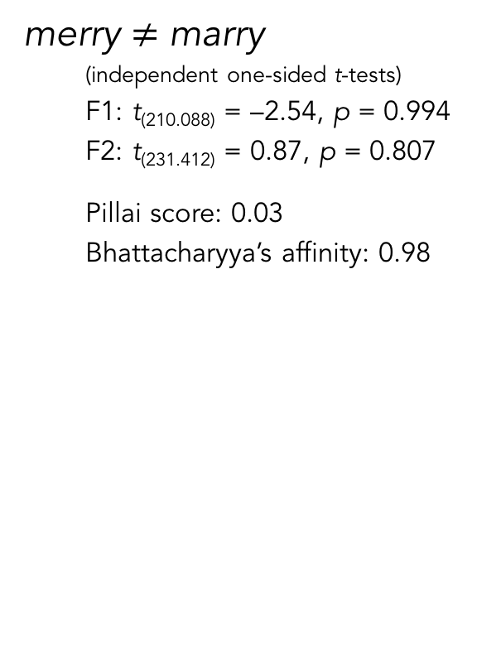
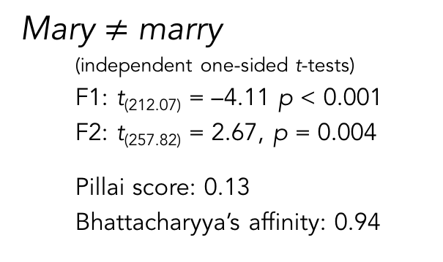
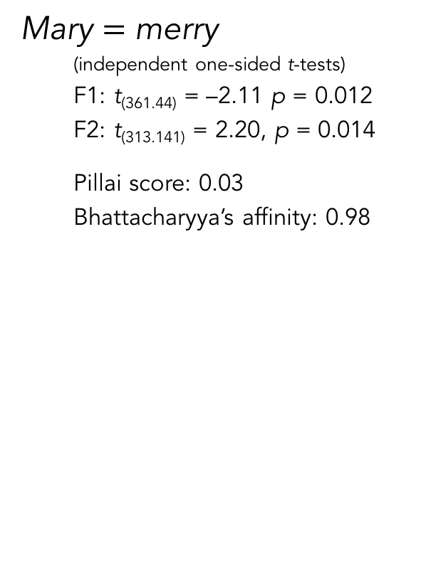
“Phoneme Continuum” Statistics
Mary $=$ merry
(independent one-sided t-tests)
F1: t_{(361.44)} = –2.11 p = 0.012
F2: t_{(313.141)} = 2.20, p = 0.014
Pillai score: 0.03
Bhattacharyya’s affinity: 0.98
merry $≠$ marry
(independent one-sided t-tests)
F1: t_{(210.088)} = –2.54, p = 0.994
F2: t_{(231.412)} = 0.87, p = 0.807
Pillai score: 0.03
Bhattacharyya’s affinity: 0.98
Marginal significance.
No significance.
Mary $≠$ marry
(independent one-sided t-tests)
F1: t_{(212.07)} = –4.11 p < 0.001
F2: t_{(257.82)} = 2.67, p = 0.004
Pillai score: 0.13
Bhattacharyya’s affinity: 0.94
Yet, more significance and less overlap.

Slide 27
Why the 25% point?

Slide 28
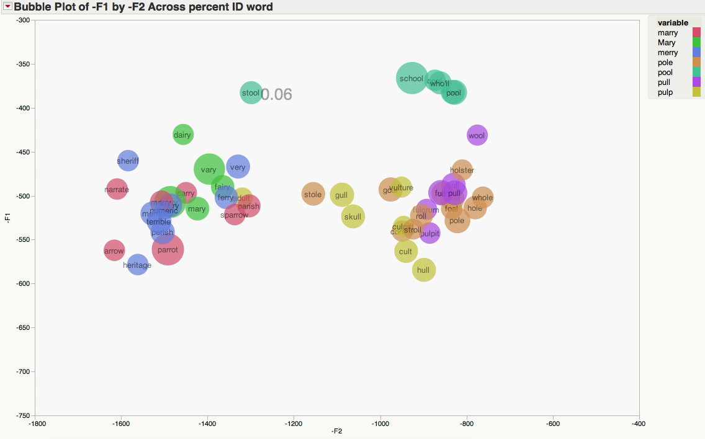
Why the 25% point?
past transitional formants
[ɫ] is in full effect (and merged for everyone) by 60%
pulp is at its lowest
pool is at its backest
mary-merry-marry at their frontest

